Slide 1
Accident and Life Support Advanced Trauma Life Support (ATLS)

Slide 2
ATLS has its origin in the Unites States in 1976, when James K Styner an Orthopedic surgeon piloting a light aircraft , crashed his plane into a field in Nebraska.
His wife was killed instantly and three of his four children sustained critical injuries.
Dr Styner had to transport them to nearest hospital.
Upon arrival, he found that the emergency care provided at the small regional hospital where they were treated was inadequate and inappropriate.

Slide 3
ATLS History

Slide 4
The initial ATLS course was held in 1978.
In 1980, the American College of Surgeons Committee on Trauma adopted ATLS and began US and international dissemination of the course,
Styner himself was recertified as an ATLS instructor in Nottingham in the United Kingdom.
The Advanced Trauma Life Support (ATLS) was therefore created initially in the USA and rapidly taken up globally.
At present over 150 countries worldwide are actively providing the ATLS course to their physician.

Slide 6
ATLS COURSE

Slide 7
Advanced Trauma Life Support

Slide 8
Basics of Trauma Assessment
Preparation .
Triage.
Primary Survey and Resuscitation .
Adjuncts to primary survey.
Secondary Survey.
Adjuncts to secondary survey.
Continued post- Resuscitation monitoring and reevaluation.
Definite Care.

Slide 9
PREPARATIONS
A- Pre- Hospital Phase.
Receiving hospital is notified first.
Send to the closest , appropriate facility.
B- In Hospital Phase.
Advanced planning for the trauma patient arrival.
Method to call extra- medical assistance.
Transfer agreement with verified trauma center established.
Protect from communicable diseases.

Slide 10
1-TRIAGE

Slide 11
2- TRIAGE

Slide 13
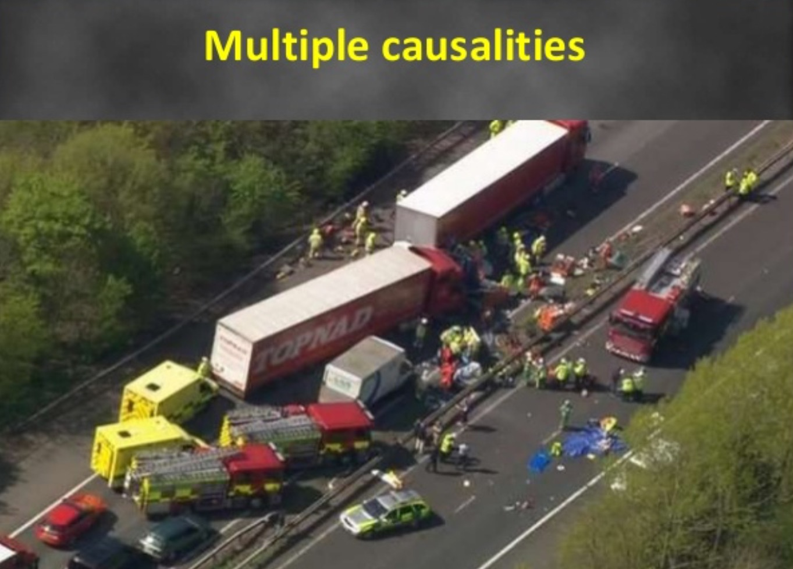

Slide 15
Field Triage – Color Coding
Triage means sorting of patients according to injury severity and need for transport.
RED : most critically injured patients- need immediate transfer to hospital.
YELLOW : less critically injured patients- delayed transfer to hospital without endangering life.
GREEN : no life/ limb threatening injury- patient ambulatory, may not need primary treatment
BLACK : dead patients.

Slide 22
PRIMARY SURVEY

Slide 23
3- PRIMARY SURVEY

Slide 24
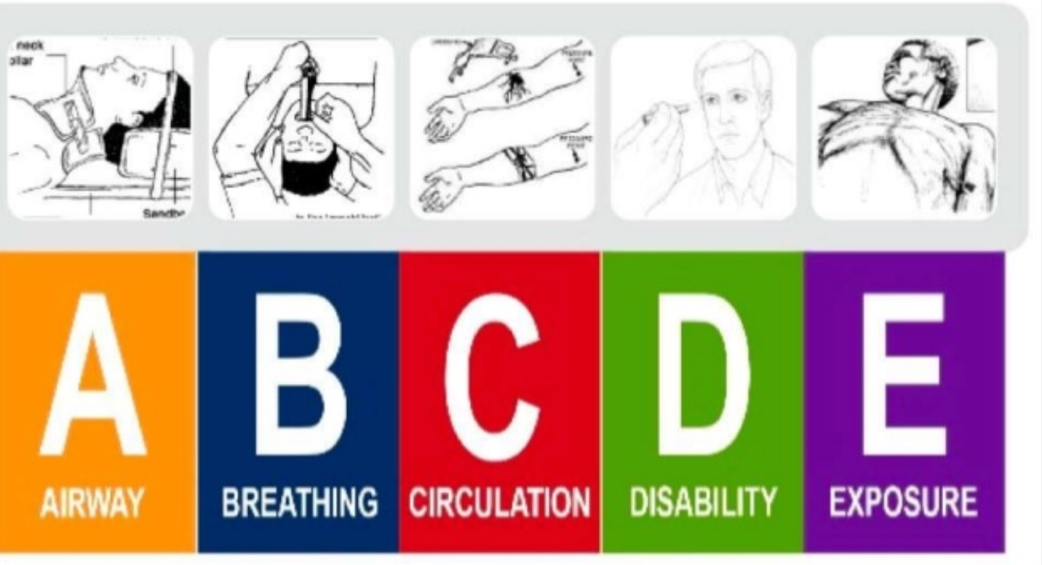

Slide 25
Airway Management

Slide 26
Protection of Spinal Cord

Slide 28
Airway Management

Slide 29
Airway management

Slide 30
Airway management

Slide 31
Airway management

Slide 32
Endotracheal Intubation

Slide 33
Airway management

Slide 34
BREATHING and VENTILATION

Slide 35
BREATHING and VENTILATION

Slide 36
BREATHING and VENTILATION

Slide 37
BREATHING and VENTILATION

Slide 38
BREATHING and VENTILATION

Slide 39
BREATHING and VENTILATION

Slide 43
CIRCULATION

Slide 44
CIRCULATION

Slide 45
CIRCULATION

Slide 46
CIRCULATION

Slide 47
DISABILITY

Slide 48
DISABILITY

Slide 49
DISABILITY

Slide 50
EXPOSURE

Slide 51
4- ADJUNCTS TO PRIMARY SURVEY

Slide 53
5- SECONDARY SURVEY

Slide 54
SECONDARY SURVEY

Slide 55
SECONDARY SURVEY

Slide 56
6- ADJUNCTS TO SECONDARY SURVEY
Include additional X-rays, CT scans, Extremity X- ray, Endoscopy, Ultrasound and all other s special procedures.

Slide 57
7- RE-EVALUATION
Adult urine out put 0.5 ml/ kg/ hr.
Pediatric urine out put 1 ml/ kg / hr.
Pain relief by effective analgesia.

Slide 58
DEFINITIVE CARE
Secondary Survey followed by radiographic evaluation
CT scan
Consultation: -Neurosurgery - Orthopedic surgery -Vascular surgery
Transfer to definitive care.
Operating theater
ICU
Higher level facility

